Slide 1


SMART INDIA HACKATHON 2024
Towards a Digitally –Driven Polio-Free Future
Problem Statement ID – SIH1537
Problem Statement Title - Teekaakaran Naagarik Portal
Theme - Medtech
PS Category- Software/Hardware
Team ID - 41116
Team Name - CareOne

Slide 2
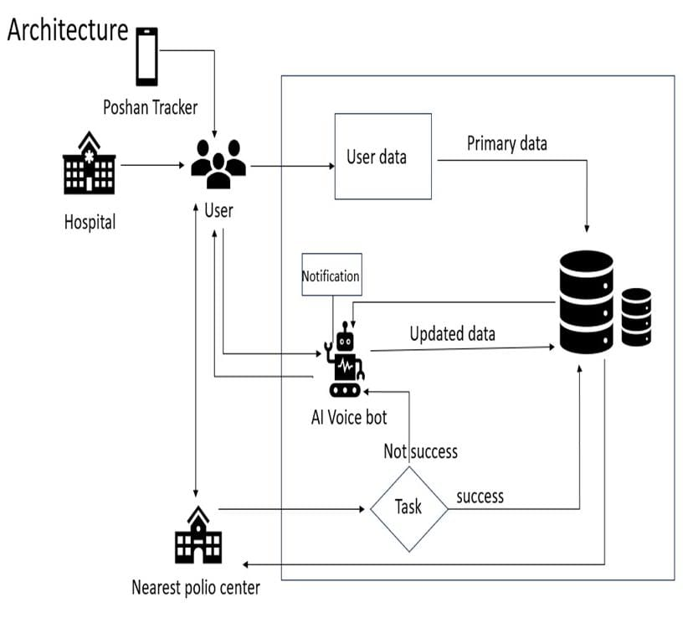

Teekaakaran Naagarik Portal (Vaccination Citizen Portal)
CareOne
Proposed Solution
In time administration of vaccination.
Rural areas face challenges in vaccination due to tech literacy and language barriers.
A web app will bridge citizens, the Health Department, and vaccination volunteers.
AI bots will communicate in local languages, gathering accurate information.
This ensures timely information reaches all, improving vaccination rates and public health.
Update and Tracking of database (Ledger)
Abstracted data
Fig: Architecture

Slide 3






TECHNICAL APPROACH
CareOne
Technologies Used | Algorithms Used
Website development: Web development integrates HTML, CSS, JavaScript, MongoDB, and React to create dynamic and responsive web application.
Smart Voice assistant: In our system, the Smart Voice Assistant calls parents to collect data and schedule polio vaccinations for their children. Technology used LIVA and/or RASA.
Automatic Speech Recognition (ASR)
Natural Language Processing (NLP) Algorithm: BERT (Bidirectional Encoder Representations from Transformers)
Speech-to-Text/ Text-to-Speech Algorithm: DeepSpeech
K-Nearest Neighbors (KNN):
Methodologies Used
Vaccination
data
AI Scheduler
Vaccine administration
Agile methodology: Flexible, iterative development focused on collaboration and feedback.
Extreme programming: Frequent releases with continuous testing and code improvement.
Dataset
AI bot
Secured data
Fig: Agile methodology

Slide 4
FEASIBILITY AND VIABILITY
CareOne
Analysis of the feasibility of the idea:
Technical Feasibility
Web Development: Create and maintain user-friendly application.
AI and NLP Tools: Evaluate tools for local language support.
Voice API Integration: Integrate voice APIs for user interaction.
Challenges: Identify issues like scalability and security.
Operational Feasibility
Ease of Use: Ensure intuitive access for all users.
Support Infrastructure: Provide adequate technical assistance and support.
Community Engagement: Involve locals in usage and feedback.
Potential challenges and risks:
Data Privacy: Secure handling of personal information.
Language Barriers: Communicate effectively in local languages.
Data Accuracy: Ensure reliable, up-to-date information.
Technical Failures: Maintain system resilience and reliability.
Training AI: Teach AI natural language understanding.
Strategies for overcoming these challenges:
Technical Failures: Backup Systems, Robust Testing Protocols, Regular Updates.
Data Accuracy: Frequent Content Updates, Integration with Health Databases.
Technological Literacy and Language Barriers: Simple Tutorials, Regular Community Feedback.

Slide 5
IMPACT AND BENEFITS
CareOne
Easy access to information worldwide, including remote areas.
Find vaccination centers and schedule appointments.
Share real-time polio outbreak and vaccination progress data.
Send personalized alerts for home vaccinations and health checkups.
Multilingual support for diverse communities.
Track child's health and vaccination progress from home.
The AI Bot and website reduce the workload on healthcare workers, enabling them to focus on critical tasks.

Slide 6
RESEARCH AND REFERENCES
CareOne
https://www.who.int/immunization/monitoring_surveillance/en/
https://www.tandfonline.com/doi/full/10.2217/fmb.15.19
https://www.poshantracker.in/
THANK YOU

